Slide 1
GastroEsophageal Reflux Disease (GERD)
DR ANN MULI

Slide 2
Definition
prolonged reflux of hydrochloric acid and pepsin in esophagus, oral cavity and respiratory system
chronic and relapsing condition
leads to esophagitis and other postinflammatory conditions of intestinal and respiratory mucosa

Slide 3
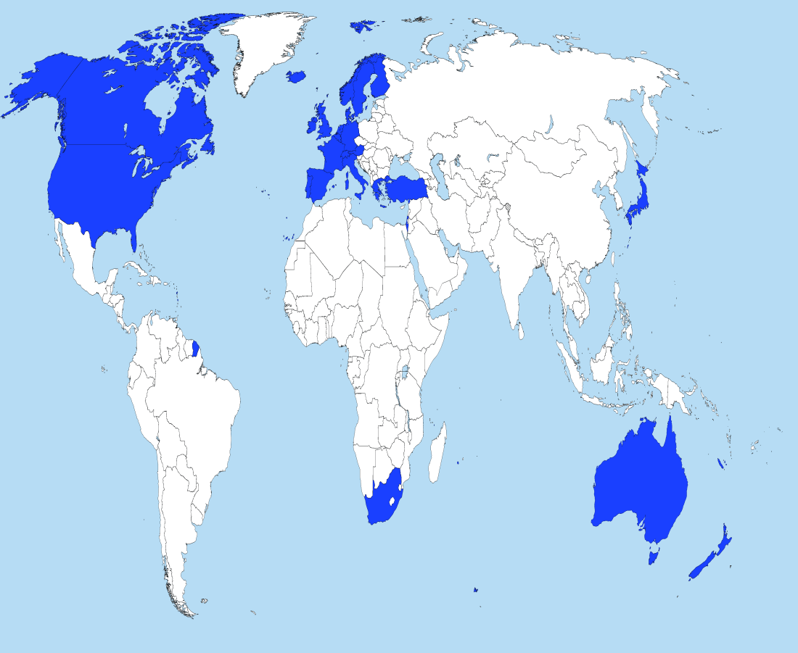
Epidemiology
developed countries
epidemic proportions; present in 40% of healthy population
adults: male, over 40
low mortality

Slide 4
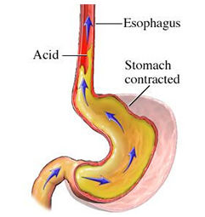
Pathophysiology
dysfunction of LES (lower esophageal sphincter)
barrier function: prevents reflux by mutual contraction with diaphragm
retains high pressure during gastric digestion

Slide 5
Risk factors
prolonged gastric emptying
obesity
pregnancy
hiatal hernia
trauma
transient LES relaxation - nocturnal, postprandial

Slide 6

Symptoms: HEARTBURN
- retrosternal burning pain - may start in abdomen and extend up into the neck

Slide 7
Other symptoms:
regurgitation - appearance of refluxed liquid in the oral cavity
respiratory symptoms – atypical symptoms connected to asthma, hoarseness, cough
nausea - resulting in vomiting - uncommon symptom

Slide 8
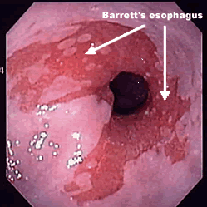
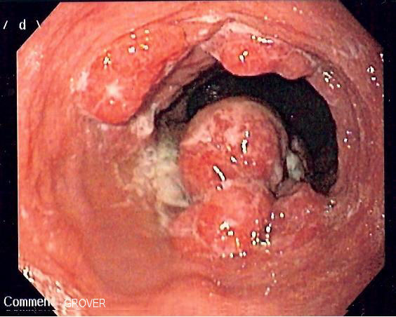
Complications:
chronic esophagitis →erosive changes
strictures →DYSPHAGIA
Barret’s esopgagus
→dysplasia
→adenocarcinoma

Slide 9
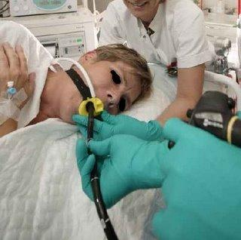
Diagnosis:
clinical – evaluation of sypmtoms, excluding other possible causes (pectoral angina)
endoscopic procedure: >esophagogastroscopy with biopsy
pH metrics: 24-hour intraluminal monitoring

Slide 10
treatment
Wt loss
Avoid chocolates, coffee,
Eat at least 3hours before reclining or sleeping.

Slide 11
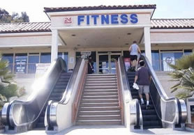




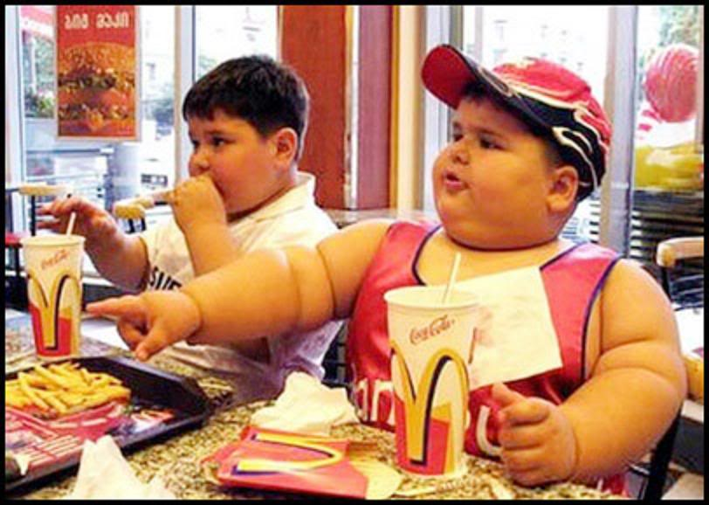

Treatment - non medicament:
Lifestyle modification:

Slide 12
Medications:
proton pump inhibitors
H2 antagonists
antacids
surgical and endocsopic procedures

Slide 13
Esophageal cancer
Squamous Cell CA
10% Proximal, 60% Middle, 30% Distal esophagus
Risk factors – Tobacco use 10x increased risk,
-Tobacco + Ethanol use 100x increased risk
Adeno CA
– Distal Esophagus/ GE Junction
– Risk – Barrett’s Esoph, GERD (incr risk 30-40x)

Slide 14
diagnosis
s/s - progressive dysphagia
Invx- upper GI endoscopy and biopsy
Mx- surgery

